Slide 1


Lecture 13:
Radioactive decay
Modern physics
Dr. Szilvási Réka
Assistant professor
BME NTI

Slide 2
Outline
Nuclear stability, the valley of stability
Understanding radioactive decay
Discussing the three types of decay modes
Exponential decay law and decay chains
Radioactive dating

Slide 3
The valley of stability
Understanding nuclear decay

Slide 4
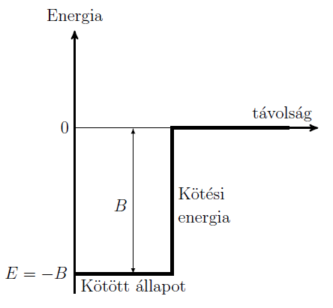
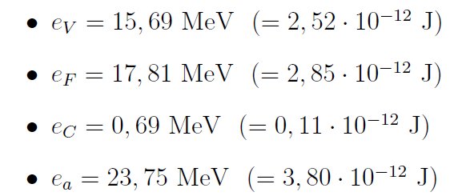


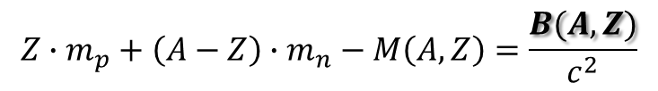


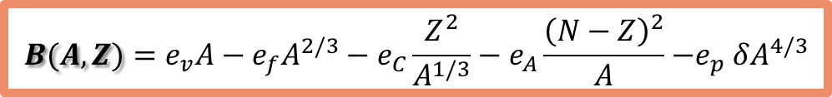
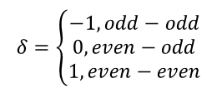
energy
$$Z∙m_{p}+\left(A−Z\right)∙m_{n}−M\left(A,Z\right)=\frac{B(A,Z)}{c^{2}}$$
distance
Binding energy
$$B(A,Z)=e_{v}A−e_{f}A^{2/3}−e_{C}\frac{Z^{2}}{A^{1/3}}−e_{A}\frac{{\left(N−Z\right)}^{2}}{A}{−e}_{p}δA^{4/3}$$
Bound state
$$δ=\left\{\begin{matrix}−1, odd−odd \\ 0, even−odd \\ 1, even−even\end{matrix}\right.$$
$$e_{p}δA^{4/3}$$
$$R_{nucleus}=r_{0}A^{1/3}$$
$E=−B<0$

Slide 5
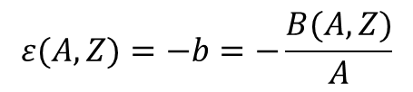
Energy valley
Investigate the average binding energy per nucleon:
$$ε(A,Z)=−b=−\frac{B(A,Z)}{A}$$

Slide 6
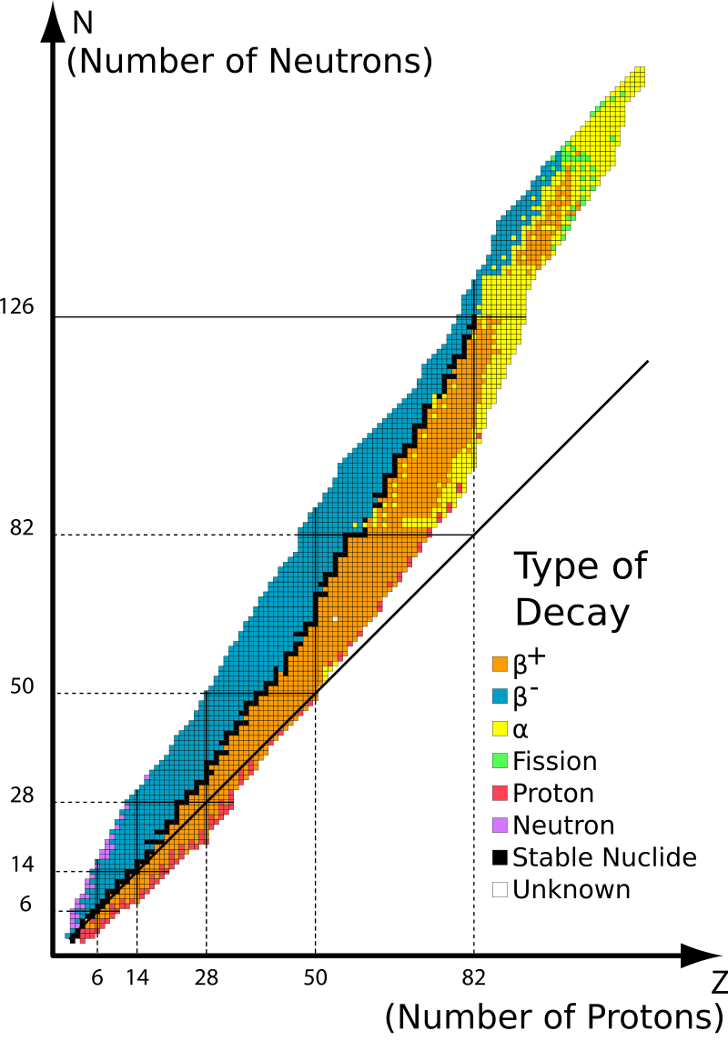
Energy valley
Investigate the average binding energy per nucleon:
$$ε(A,Z)=−b=−\frac{B(A,Z)}{A}$$

Slide 7
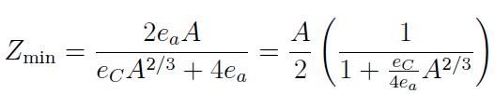
Energy valley
Investigate the average binding energy per nucleon:
$$ε(A,Z)=−b=−\frac{B(A,Z)}{A}$$
Z=N
for not too large A: Z_{min}=A/2
light nuclei tend to have equal number of protons and neutrons; small fermion number asymmetry

Slide 8
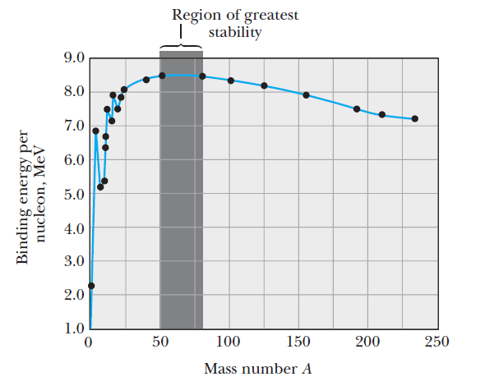
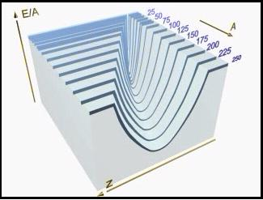
Energy valley
Investigate the average binding energy per nucleon:
$$ε(A,Z)=−b=−\frac{B(A,Z)}{A}$$
For a bound system the energy of the system is negative, hence the binding energy is positive!
BUT! A bound system does not necessarily mean stable!
binding energy!
(the more positive the more stable)
energy!
(the more negative the more stable)

Slide 9
Energy valley
Investigate the average binding energy per nucleon:
$$ε(A,Z)=−b=−\frac{B(A,Z)}{A}$$
For a bound system the energy of the system is negative, hence the binding energy is positive!
BUT! A bound system does not necessarily mean stable!
Line of stability
Every sponteneous nuclear process is governed by the aspiration of nuclei to lower their energies (increase their binding energies)

Slide 10
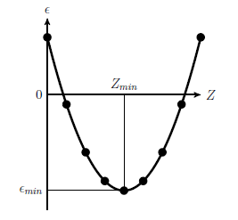
Energy valley
Investigate the average binding energy per nucleon:
$$ε(A,Z)=−b=−\frac{B(A,Z)}{A}$$
For a bound system the energy of the system is negative, hence the binding energy is positive!
BUT! A bound system does not necessarily mean stable!
Atomic number
Every sponteneous nuclear process is governed by the aspiration of nuclei to lower their energies (increase their binding energies)

Slide 11
Radioactive decay modes
Alpha, beta, gamma decay

Slide 12
Conserved quantities
Space-time symmetries:
Internal symmetries (charges)
Electric charge
Energy (time translation symmetry)
Barionic charge (nucleon number)
Momentum (space translation symmetry)
Leptonic charge (light fermion number)
Angular momentum (rotational symmetry)

Slide 13



Alpha decay (indtroduction)
$${}_{Z}^{A}X→$$
$${}_{Z−2}^{A−4}{Y+}$$
$${}_{2}^{4}{He}$$
Why does the decay happen?
How can the decay happen?

Slide 14
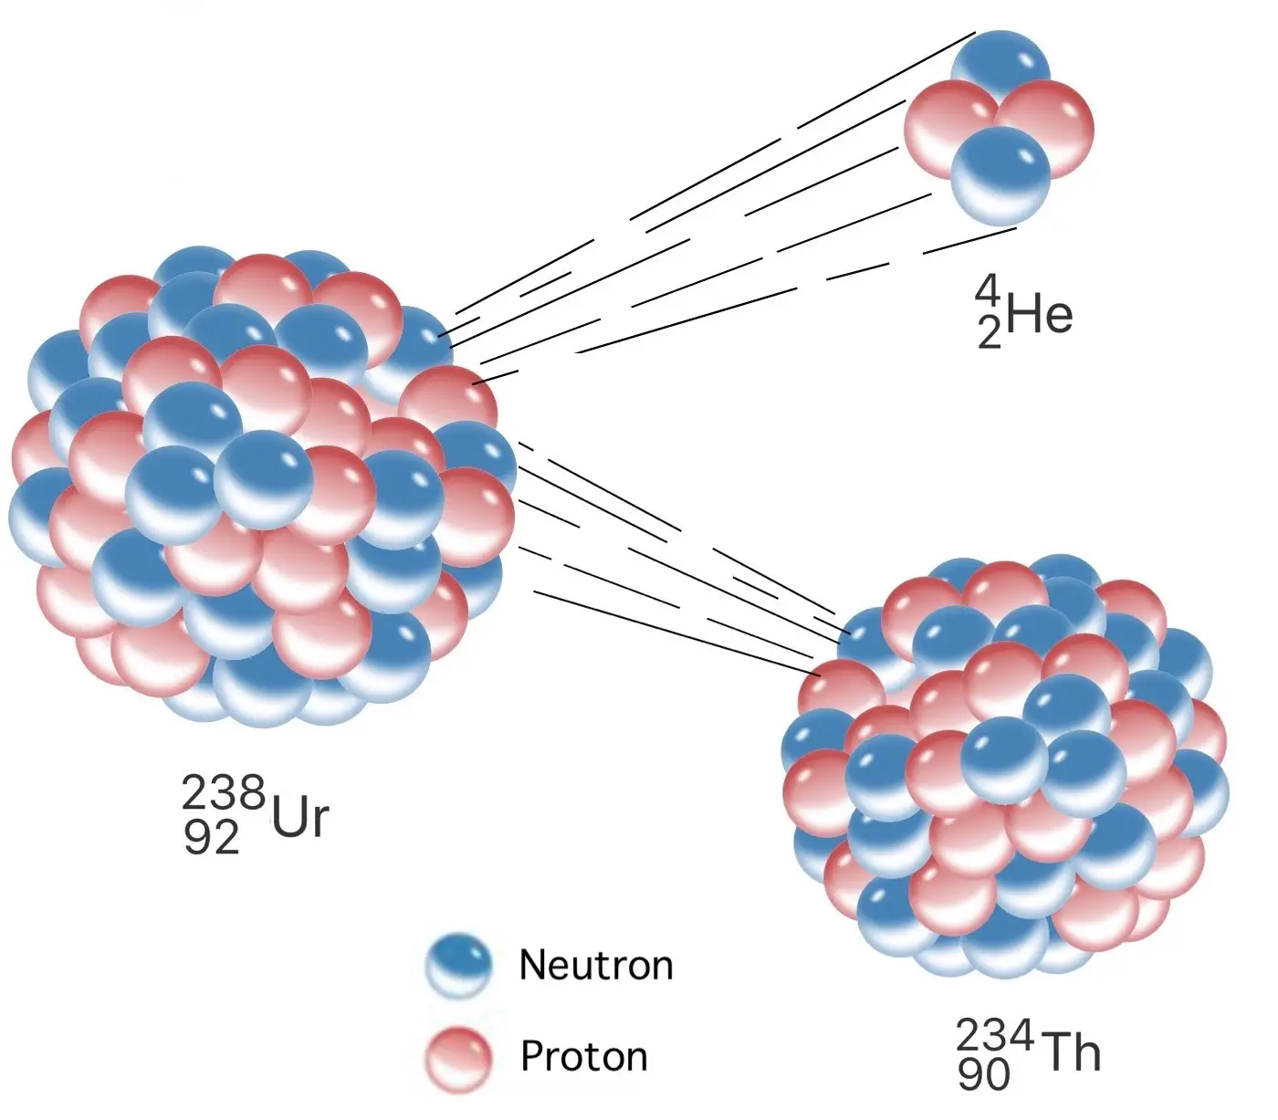
Alpha decay (indtroduction)
$${}_{Z}^{A}X→$$
$${}_{Z−2}^{A−4}{Y+}$$
$${}_{2}^{4}{He}$$
Why does the decay happen?
The decay products more tightly bound than the parent
  Check the binding energy difference
Characterizing the decay by the
  desintegration (decay) energy Q (4-10 MeV)
  half life T (or τ lifetime) (varies from micro seconds to billion years…)

Slide 15
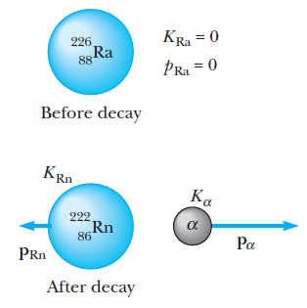

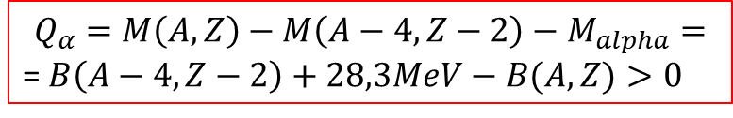
Alpha decay (indtroduction)
$${}_{Z}^{A}X→$$
$${}_{Z−2}^{A−4}{Y+}$$
$${}_{2}^{4}{He}$$
Why does the decay happen?
The decay products more tightly bound than the parent
  Check the binding energy difference
Characterizing the decay by the
  desintegration (decay) energy Q
  half life T (varies from micro seconds to billion years…)
Disintegration (decay) energy:
$$Q_{α}=M\left(A,Z\right)−M\left(A−4,Z−2\right)−M_{alpha}=$$
= $B\left(A−4,Z−2\right)+28,3MeV−B(A,Z)>0$
mostly the kinetic energy of the alpha particle emitted (recoil can be neglected)

Slide 16
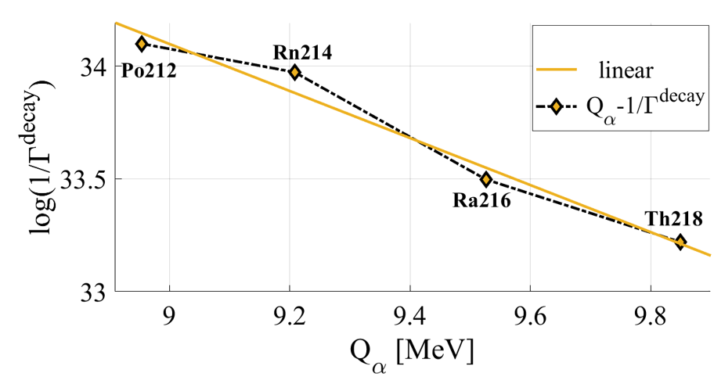
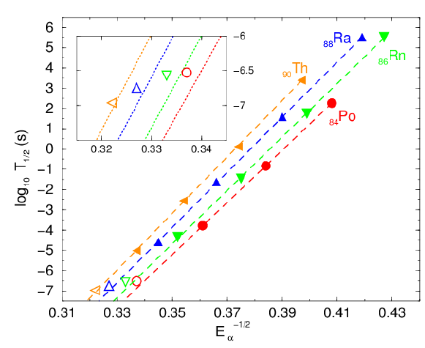

Alpha decay (indtroduction)
Why does the decay happen?
$${}_{Z}^{A}X→$$
Why does the decay happen?
$${}_{Z}^{A}X→$$
$${}_{2}^{4}{He}$$
$${}_{Z−2}^{A−4}{Y+}$$
$${}_{2}^{4}{He}$$
$${}_{Z−2}^{A−4}{Y+}$$
The decay products more tightly bound than the parent
  Check the binding energy difference
Characterizing the decay by the
  desintegration (decay) energy Q
  half life T (varies from micro seconds to billion years…)
  Geiger-Nuttal law (empirical…)
1/2

Slide 17
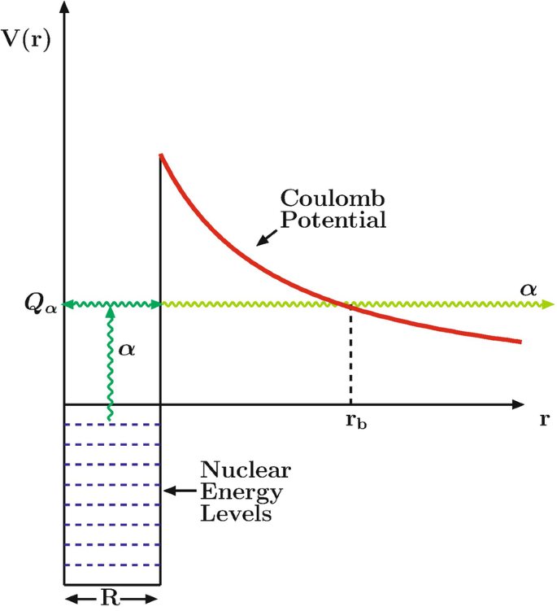
Alpha decay (indtroduction)
Why does the decay happen?
$${}_{Z}^{A}X→$$
Why does the decay happen?
How can the decay happen?
$${}_{Z}^{A}X→$$
$${}_{2}^{4}{He}$$
$${}_{Z−2}^{A−4}{Y+}$$
$${}_{2}^{4}{He}$$
$${}_{Z−2}^{A−4}{Y+}$$
The decay products more tightly bound than the parent
  Check the binding energy difference
Characterizing the decay by the
  desintegration (decay) energy Q
  half life T (varies from micro seconds to billion years…)
Alpha-particle emission cannot be understood by classical physics!!
Disintegration (decay) energy:
$$Q_{α}=M\left(A,Z\right)−M\left(A−4,Z−2\right)−M_{alpha}=$$
= $B\left(A−4,Z−2\right)+28,3MeV−B(A,Z)>0$
A new, pure quantum process: tunneling

Slide 18


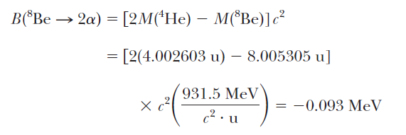
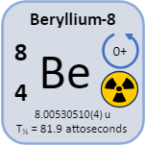
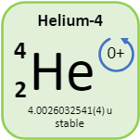
Alpha decay (indtroduction)
EXAMPLE:
Positive binding energy (mass of free parts minus mass of bound): could be a bound system
Δ
decay happens spontaneously
difference in the masses of the two alpha particles and the beryllium nucleus: negative means unstable against decay to two alphas

Slide 19
Beta decay
the emitted particle is a high-energy electron or positron (beta particles)
  cannot be bound in the nuclues must be created at the moment of decay
the mass number does not change (A=cst. isobar transition)
the atomic number changes by 1 (either increases or decreases)
  a neutron proton state transition inside the nucleus
  a beta decaying nucleus has an excess of neutrons or protons
β⁻:
β⁺:

Slide 20
Beta decay
the emitted particle is a high-energy electron or positron (beta particles)
  cannot be bound in the nuclues must be created at the moment of decay
the mass number does not change (A=cst. isobar transition)
the atomic number changes by 1 (either increases or decreases)
  a neutron proton state transition inside the nucleus
  a beta decaying nucleus has an excess of neutrons or protons
Measure the energy spectrum of the beta particles (Q-value, kinetic energy of the system (recoil is negligible)
  it should be: a certain type of nucleus a determined beta energy

Slide 21
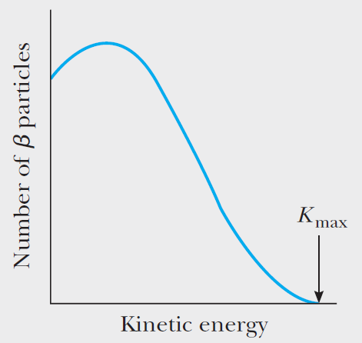

Beta decay
the emitted particle is a high-energy electron or positron (beta particles)
  cannot be bound in the nuclues must be created at the moment of decay
the mass number does not change (A=cst. isobar transition)
the atomic number changes by 1 (either increases or decreases)
  a neutron proton state transition inside the nucleus
  a beta decaying nucleus has an excess of neutrons or protons
Measure the energy spectrum of the beta particles (Q-value, kinetic energy of the system (recoil is negligible)
  it should be: a certain type of nucleus a determined beta energy
  result: continuous spectrum!

Slide 22
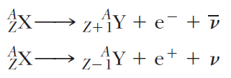


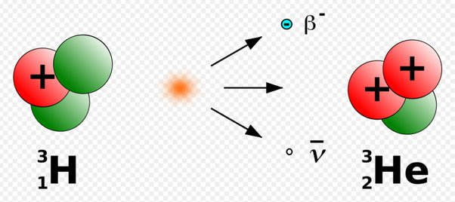

Beta decay
  continuous spectrum!
    Energy conservation violated?
    What could carry away the missing energy?
    Pauli: another particle (three-body problem), the neutrino (Fermi)
      Electrically neutral
      Lepton type
      Spin ½
      Tiny mass
      Weakly interacting
β⁻:
EC:
β⁺:
beta-type weak process
treshold! (m_{electron}=m_{positron})

Slide 23
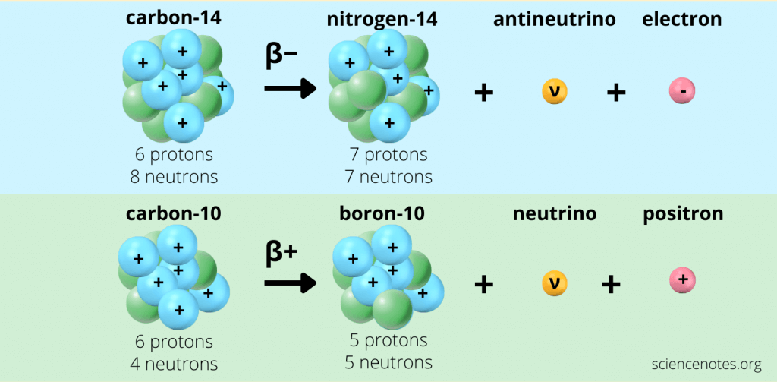
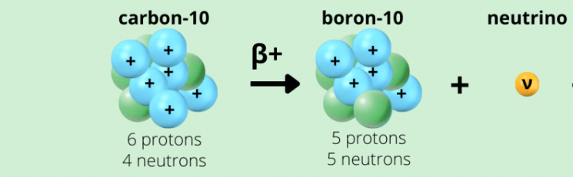

β⁺:
EC:
Two competing processes
Q for β⁺ is always 1 MeV smaller than that for EC
EC typically happens with K-shell electrons
Q=2,6 MeV
electron +
EC
+
Q=3,6 MeV

Slide 24
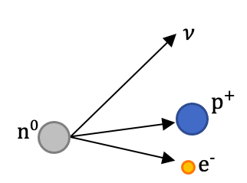
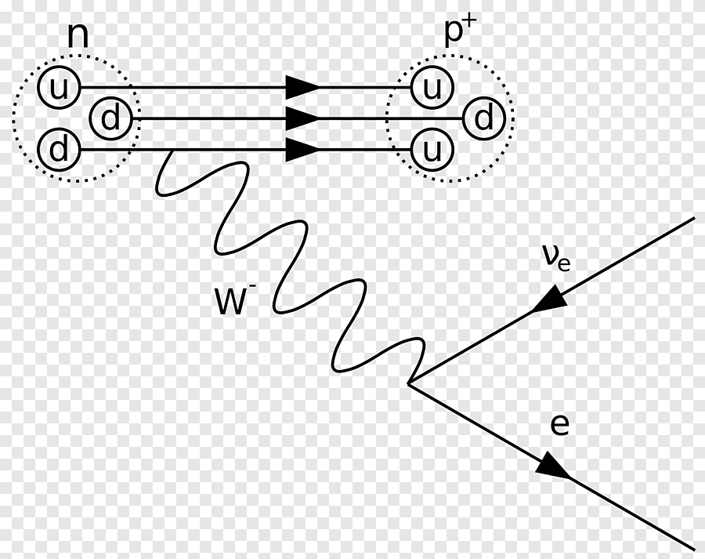
Beta decay as a weak interaction
At the level of the nucleus:
Nuclear state transition!
Not free nucleon states!
  That is why β+ is allowed
At the level of the nucleons:
Similar process: decay of a free neutron (n, p mass eigenstates)
Reverse process is forbidden! (free p to free n)
At the level of the quarks:
charged current weak interaction: transition between bound quarks (u d)

Slide 25
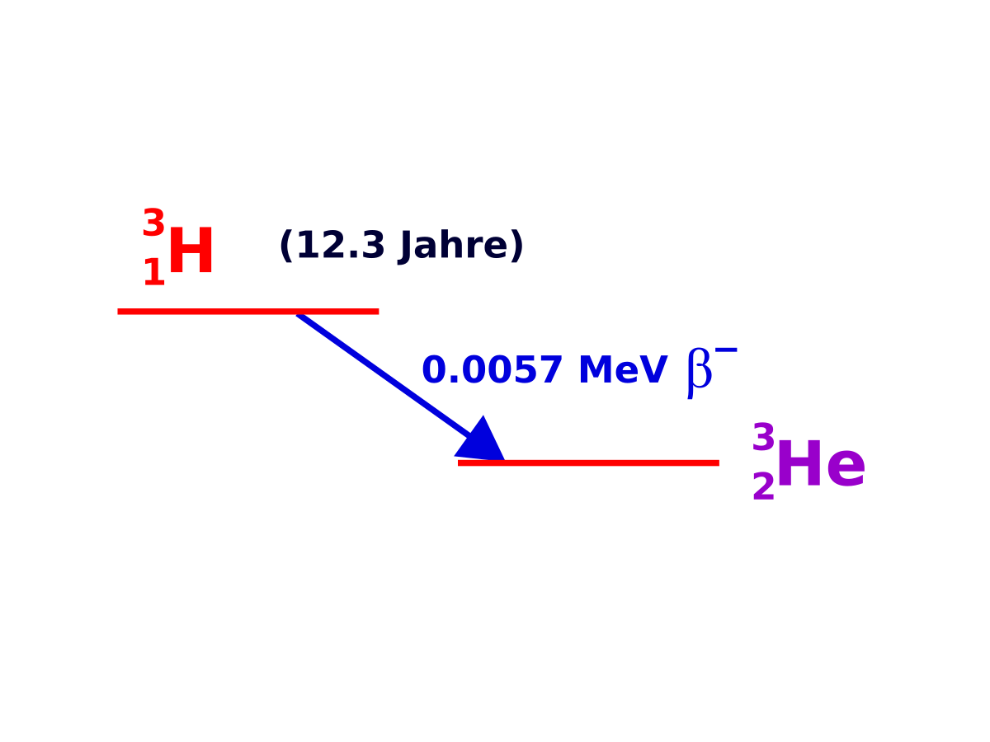
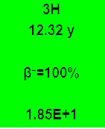

Beta decay
β⁻:
EXAMPLE:
average beta energy
0.01859 MeV
maximum beta energy = decay energy

Slide 26
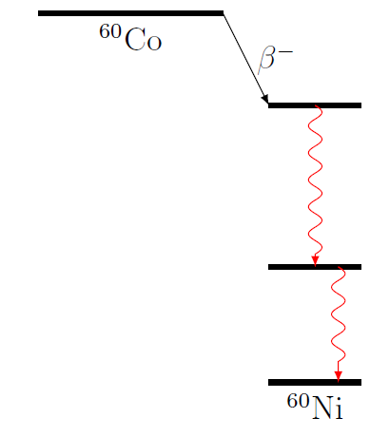

Gamma decay
    nuclear transition without changing the constituents
    some nuclear processes result in a daughter nucleus in an excited state (example: beta decay)
    the system wants to lower its energy transitions down to lower-enrgy levels if there are any available
      By emitting gamma (!) photons (energy in MeV scale)
      Energy of the photons are determined by the difference in the nuclear energy levels:
ΔE₁
ΔE₂
ΔE₁=hf₁
characteristic photon frequency

Slide 27
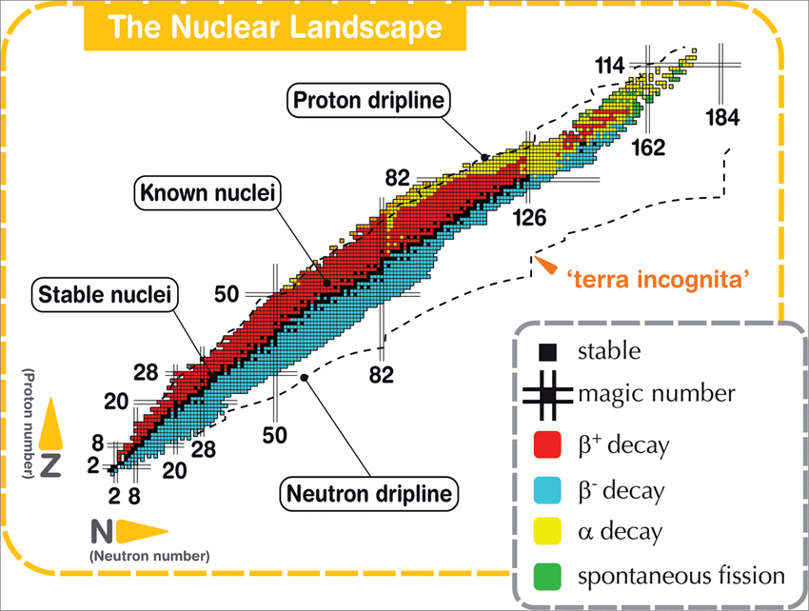

Slide 28
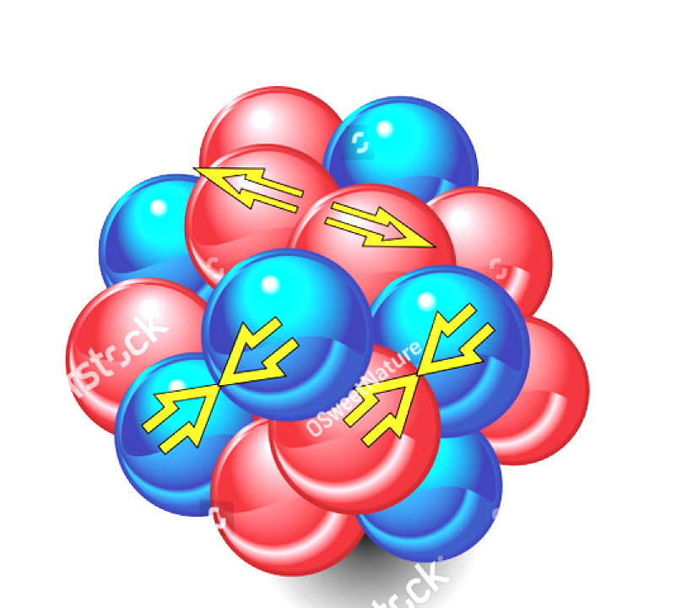
Quiz
https://quizizz.com/admin/assessment/6807ad97c951d10977d0cbbc?source=lesson_share
CODE: 3169 7812

Slide 29
Statistical properties of radioactivity
Exponential decay law, decay chains, radioactive dating

Slide 30


Exponential decay law
Radioactive decay is a spontenaous process that is governed by elementary quantum mechanical processes in the nucleus
It has a probabilistic nature!
Take a large number of nuclei: N apply statistical principles!
How the number of radioactive nuclei present changes by time?
the number N(t) decreases:
$$dN=N\left(t+dt\right)−N\left(t\right)<0$$

Slide 31
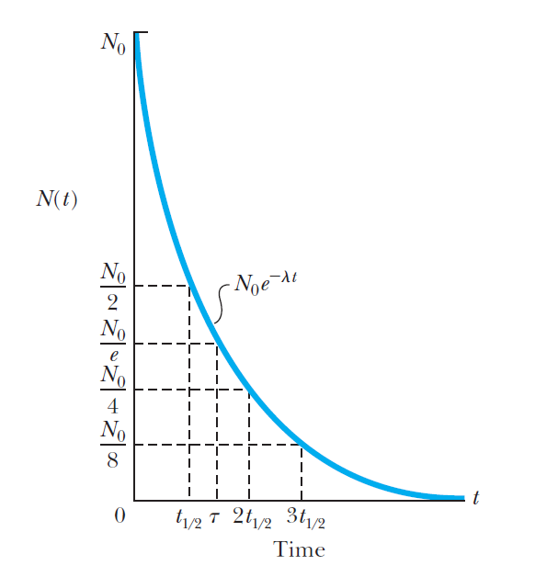
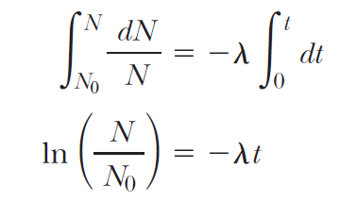
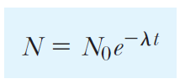
Exponential decay law
Radioactive decay is a spontenaous process that is governed by elementary quantum mechanical processes in the nucleus
It has a probabilistic nature!
Take a large number of nuclei: N apply statistical principles!
How the number of radioactive nuclei present changes by time?
the number N(t) decreases:
$$dN=N\left(t+dt\right)−N\left(t\right)<0$$
Solve the differential equation!

Slide 32

Exponential decay law
Radioactive decay is a spontenaous process that is governed by elementary quantum mechanical processes in the nucleus
It has a probabilistic nature!
Take a large number of nuclei: N apply statistical principles!
How the number of radioactive nuclei present changes by time?
the number N(t) decreases:
$$dN=N\left(t+dt\right)−N\left(t\right)<0$$
Number of decays per unit time: activity
$$A=$$
Solve the differential equation!

Slide 33
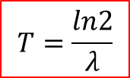

Exponential decay law
How the number of radioactive nuclei present changes by time?
Number of decays per unit time: activity
$$A=$$
[1/s]=Bq
Decay probability of a nucleus per unit time – decay constant (although it is not a universal constant, it is a resultant of elementary processes!)
[1/s]
$$T=\frac{ln2}{λ}$$
Half-life

Slide 34
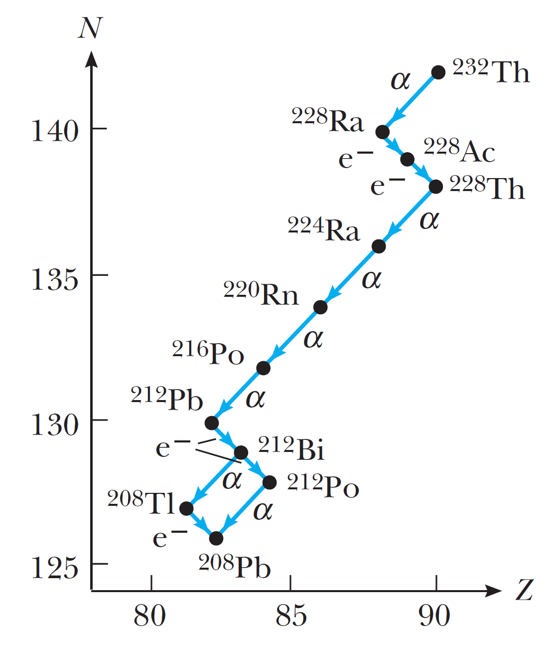

Natural radioactivty: decay chains
Radioactive decay continues until the valley of stability is reached
Beta decay changes Z
Alpha decay changes A
$A\underset{→}{α−decay}A−4:$
Remainder when devided by 4?
4 decay series

Slide 35


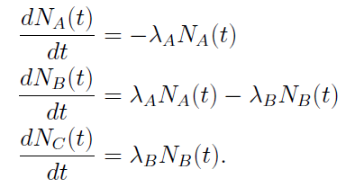

Natural radioactivty: decay chains
Radioactive decay continues until the valley of stability is reached
decay series
Secular equilibrium if for any isotope t->∞ and T_{B}<<T_{A}

Slide 36
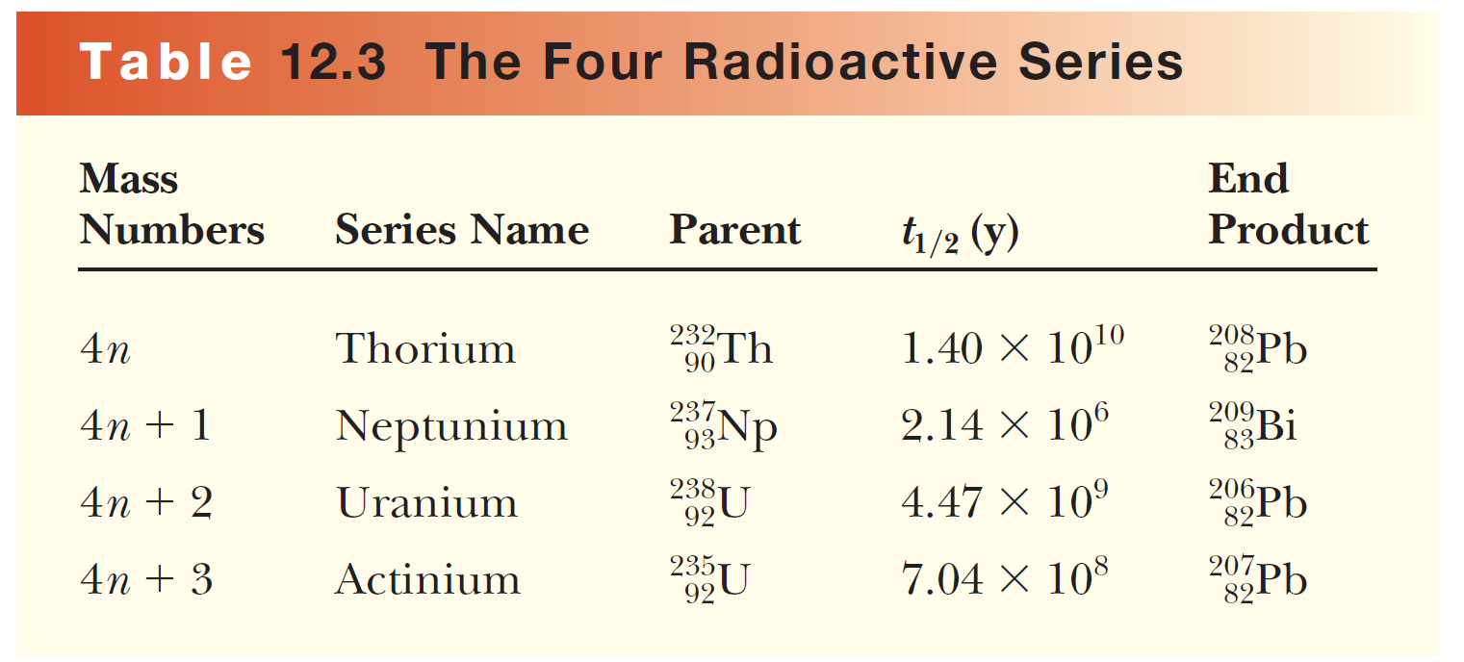
Natural radioactivty: decay chains
stable isotopes
Artificial,
those formed at the birth of the Earth already decayed away
Question: age of the Earth?
T_{p}>>T_{d}
transuranic

Slide 37

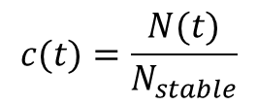
Application: radioactive dating
The half life determines the time-scale accessible
Carbon dating
Tritium dating
Lead-helium dating
Isotope | Half life (years) | Relative abundance
³H (tritium) | 12,262 | 1 · 10⁻¹⁸
¹⁴C (radiocarbon) | 5568 | 2 · 10⁻¹²
⁴⁰K | 1,3 · 10⁹ | 1,19 · 10⁻⁴
⁸⁷Rb | 5 · 10¹⁰ | 0,278
²³⁸U | 4,51 · 10⁹ | 0,992739
²³⁵U | 7,04 · 10⁸ | 0.007204
²³²Th | 1,39 · 10¹⁰ | 1.0
Use: relative number
c decays exponentially
$$c(t)=\frac{N(t)}{N_{stable}}$$
$$c\left(t\right)=c_{0}e^{−λt}$$

Slide 38
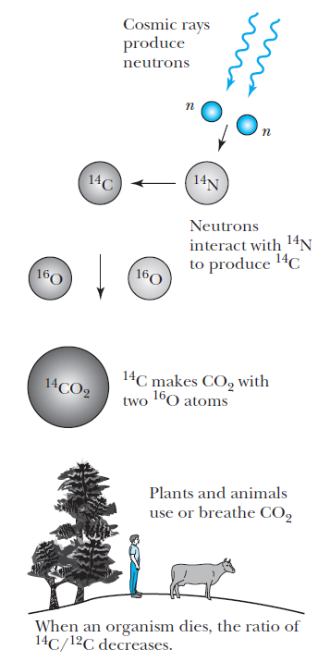

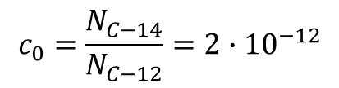
Application: radioactive dating
The half life determines the time scale accessible
Carbon dating
Tritium dating
Lead-helium dating
relative abundance
$$c_{0}=\frac{N_{C−14}}{N_{C−12}}=2∙{10}^{−12}$$
$${}_{7}^{14}{N+n→}{}_{6}^{14}{C+p}$$
measuring activity and mass
cosmic origin: ¹⁴C is produced continuosly; also forms CO₂
decays with half life T_{14C}=5730 years
natural equilibrium with ¹²C for living organisms
at the time of death: c₀ decays according to T_{14C}

Slide 39
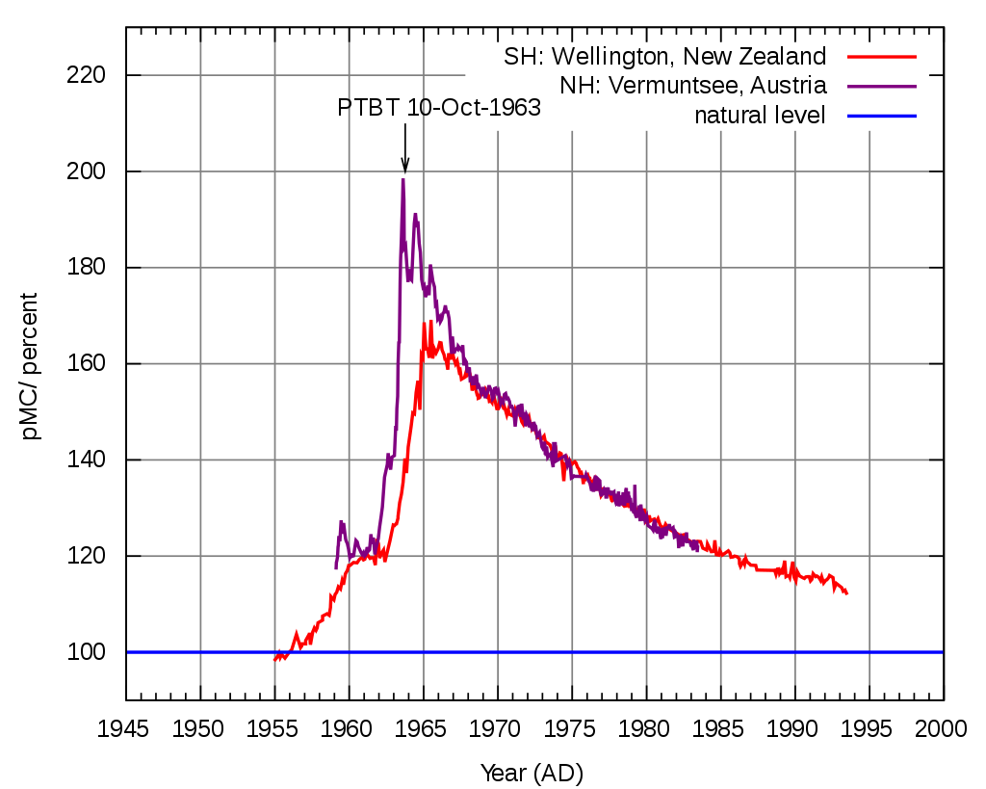
Relative abundance of ¹⁴C
?

Slide 40
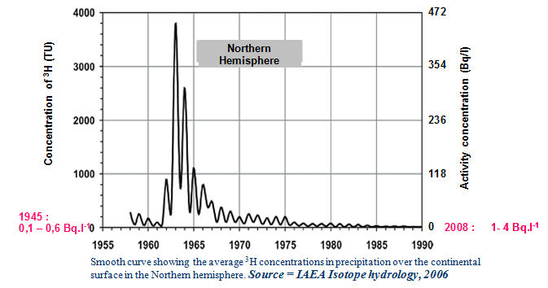
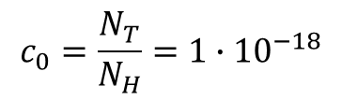

Application: radioactive dating
The half life determines the time scale accessible
Carbon dating
Tritium dating
Lead-helium dating
$$c_{0}=\frac{N_{T}}{N_{H}}=1∙{10}^{−18}$$
$${}_{7}^{14}{N+n→}{}_{6}^{12}{C+T}$$
cosmic origin: ³H is produced continuously
decays with half life T=12,3 years
³H is abundant in water: for not isolated water equilibrium
for isolated water the relative abundance decreases with T

Slide 41
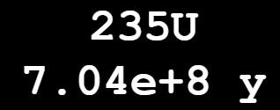


Application: radioactive dating
The half life determines the time scale assessible
Carbon dating
Tritium dating
Lead-helium dating
Utilizing the natural decay series! Age of rocks?
Thorium, Uranium
They end with a Pb isotope (hard to separate them…)
A given number of alpha particles (He) produced
(accumulates in the fractures of the rock)
Method:
$$N_{now}=N_{initial}e^{−λt}$$
=$N_{now}+N_{lead}$
By measuring the activity now,
deduce the uranium/thorium amount now

Slide 42
Natural radioactivty: decay chains
stable isotopes
Artificial,
those formed at the birth of the Earth already decayed away
Question: age of the Earth?
T_{p}>>T_{d}
transuranic

